Slide 1




STATS N FACTS
Social Media
VS
Mental Health

Slide 2



STATS N FACTS
TEAM MEMBERS
Ananya Verma - E22CSEU0773
Atishya Pradhan – E22CSEU0759
Saavi Mittal – E22CSEU775
Bhavesh Pareta – E22CSEU0778

Slide 3


This study aims to investigate the correlation between daily social media usage and mental health outcomes. Data from a representative sample will be analyzed using statistical methods including correlation and regression analysis. The project seeks to determine whether a significant relationship exists between social media use and mental health, potentially providing insights into the impact of social media on well-being and informing future interventions and guidelines.
ABSTRACT
Mental Health
VS
Social Media

Slide 4




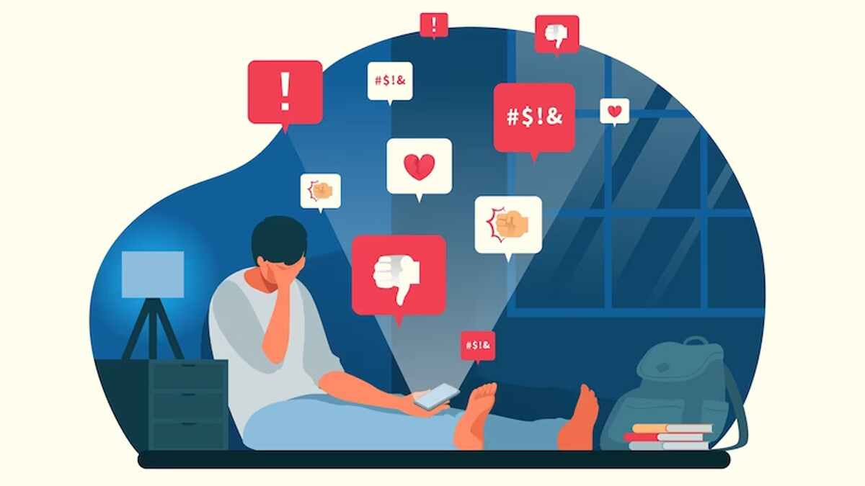
INTRODUCTION
Rising Concerns: Social media's impact on mental health is a growing concern
Research Objective: Analyze the relationship using statistical methods
Significance: Important for individuals and policymakers
Hypotheses: Null and alternative hypotheses are established
Structure: Overview of project's methodology and implications

Slide 5


METHODS
Data Collection:Gather data on social media usage (minutes/day) and mental health scores.
Use standardized assessments for mental health.
Data Analysis:Calculate correlation to assess the relationship.
Utilize regression analysis to predict mental health outcomes.
Statistical Testing:Conduct hypothesis tests for significance.
Data Visualization:Create visual representations of data.
Future Research:Suggest areas for future studies and interventions.

Slide 6


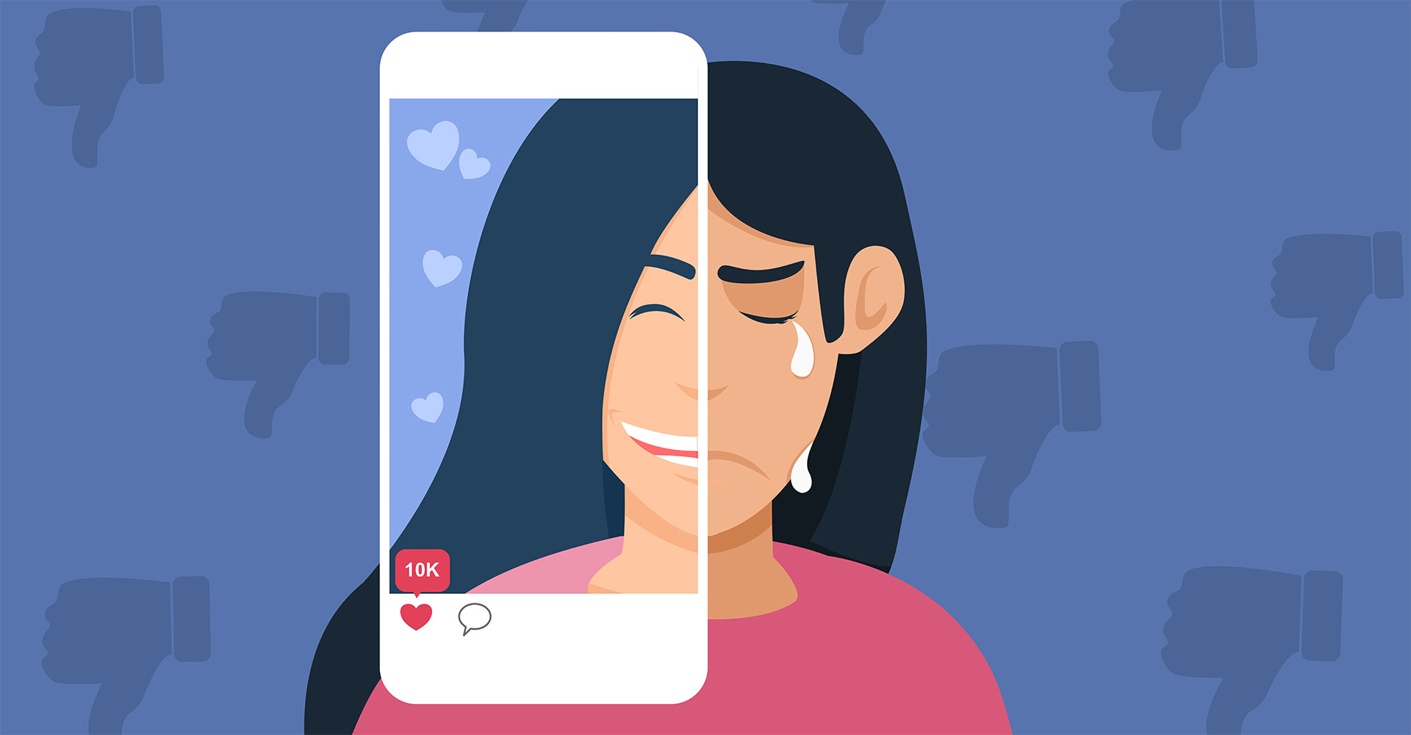



Social Media Affects

Slide 7



RESULTS
Positive Correlation: The study may find a statistically significant positive correlation between increased daily social media usage and better mental health outcomes. This would suggest that social media can have a positive influence on well-being.
Negative Correlation: Alternatively, the research might reveal a statistically significant negative correlation between higher social media usage and poorer mental health outcomes, implying that excessive social media use is detrimental to mental well-being.
No Significant Relationship: It's also possible that the study finds no statistically significant relationship between social media usage and mental health outcomes. In this case, social media may not be a significant factor influencing mental health.

Slide 8


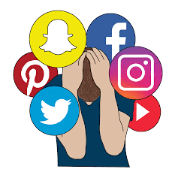
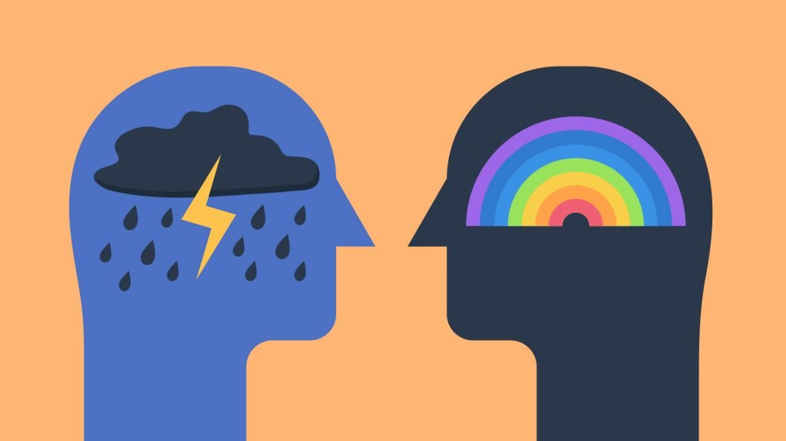



Slide 9



CONCLUSION
The findings from the analysis of the relationship between social media usage and mental health outcomes present a multifaceted landscape.
A positive correlation would suggest the potential for social media to positively impact mental health through fostering connections and support.
Conversely, a negative correlation would emphasize the risks of excessive use, highlighting the need for mindful consumption and balanced digital habits.
A non-significant relationship would indicate that social media might not be the sole determinant of mental health outcomes, prompting further exploration of other contributing factors.
Regardless of the specific outcome, the study underscores the significance of promoting responsible social media use, digital well-being, and mental health awareness. A holistic approach involving education, supportive online environments, and ongoing research remains essential to cultivate a healthier relationship between social media and mental well-being.

Slide 10




Thank you!

